Slide 1
Automated Maintenance System Realization
June 18,2023
Kimberly-Clark Singapore Tuas Mill

Slide 2
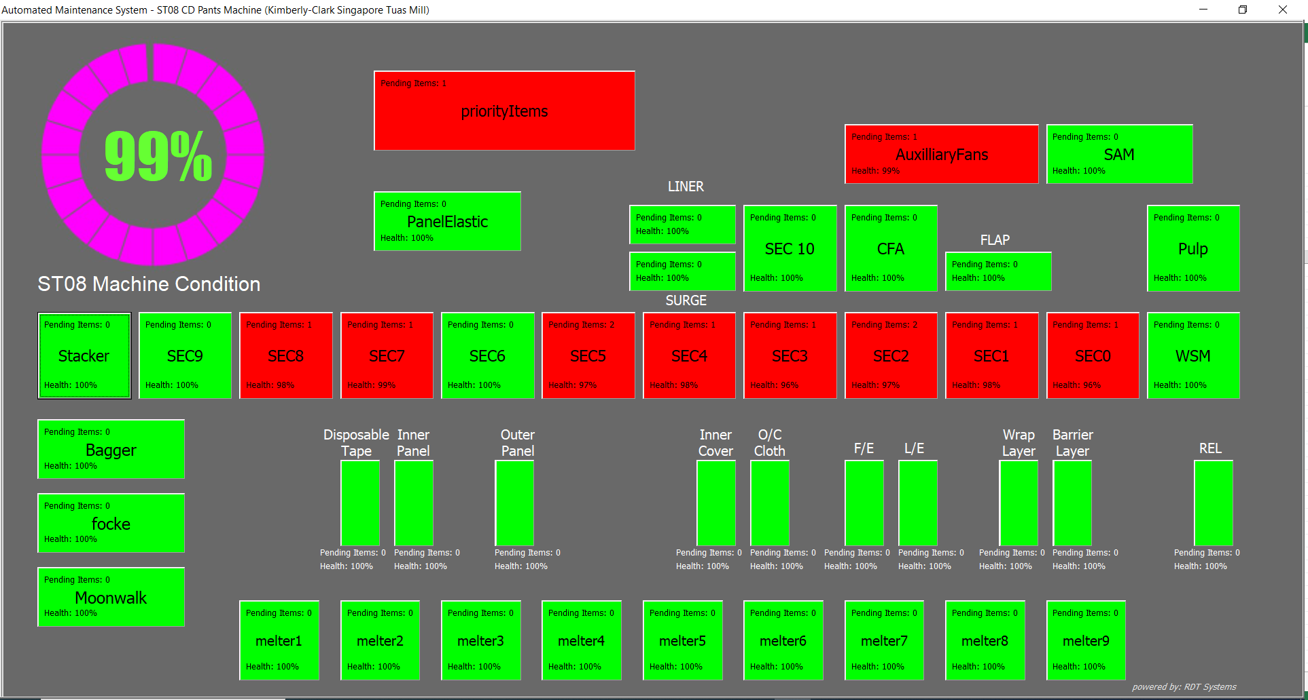
User Interface (simple, clean, informative UX/UI in actual machine setup layout)
Dynamic Visual Info’s and Interactive Controls

Slide 3
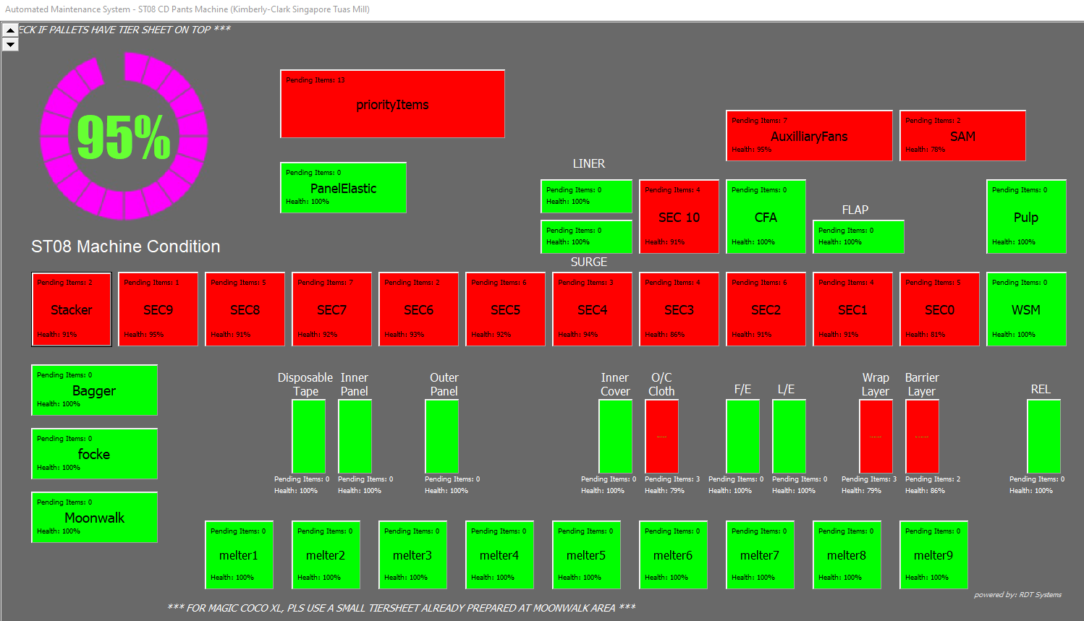
Dynamic Visual Info’s
7
Overall machine health condition
Pending items per section
Health condition per section
Green buttons means, zero pending items (100% healthy)
Red button shows that there is a needed maintenance item for a particular section
Top and Bottom banners for reminders, announcements, etc.
Zoom control to fit all screen size
2
1
4
3
5
6

Slide 4
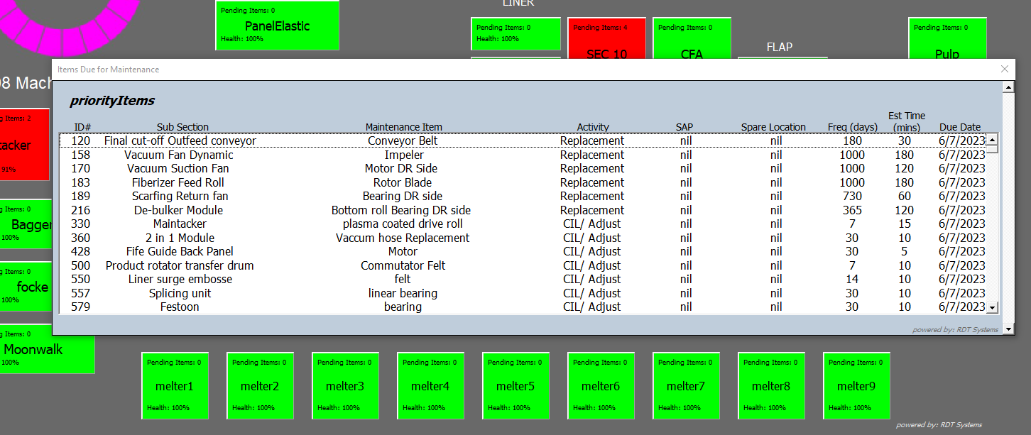
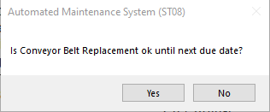
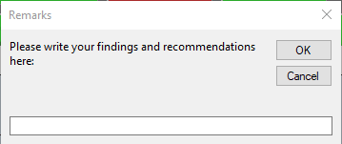
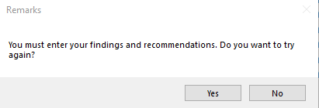
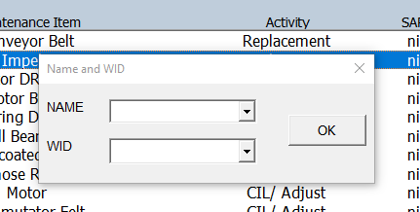
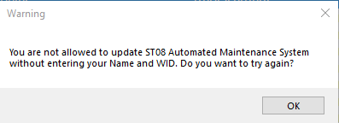
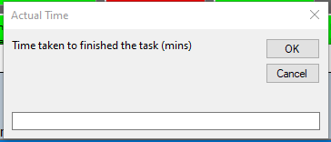
Interactive Controls
After task completion condition verification
Findings and Recommendations if any
Selectable item list pops-out after a red button is clicked
Actual Time taken on task completion
UserName and WID verication before system update is allowed

Slide 5


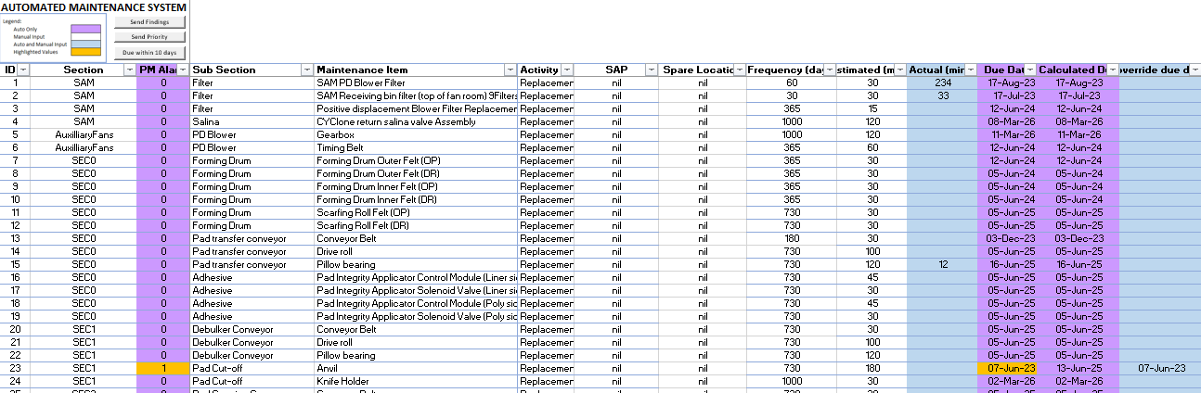



Database (in excel sheet, which everyone is familiar with and for easy data migration)
Database Auto Update from UI inputs
Date done
Done by who
Dates done historical data
Findings and Suggestions
Due date
2. Auto Daily Email Notifications
Priority Items
Items with Findings and Suggestions from the crew
Parts replacement due within 10 days
3. User Controllable Items after data review
Override Due date
Select Priority items
Button click for manual sending of updates (email)

Slide 6
Process Flow:
Start
From UI, User will click on a button
Simple and User – Friendly design
Is it Red?
No
Blank List will appear
A
A
Yes
List of pending items for a particular section will appear
Cancelled
Findings and Suggestions Entered?
No
Yes
User will select the item row
No
Exit
No
A
Name and WID match?
Item condition ok until next due date?
Time Taken in mins? entered
User will be required to enter his name and WIF
Yes
Yes
Yes
Database will auto update
A
Cancelled
A
Cancelled
A
Cancelled

Slide 7
System requirements:
MS Office 2019 or higher
Latest VBA Update
Dedicated PC or Shared PC but no other excel file is used on that PC cause UI in VBA form will not allow other excel file to run while it is in use
Outlook account to enable auto email sending of updates
Share point access

